Slide 1
FSA Electric Press

Slide 2
Introduction
FSA, alongside to its assembly machine core business, and coming from a long expertise in tightening and press-fit system, is producing electric press-fit systems, designed for industry. These standardized products are electric actuator which are integrated in assembly lines or test and control bench.

Slide 3
FSA designs and uses its own PRESS for its Assy Lines since Y2000…
Jan. 2020

Slide 4
FSA ranges of servo presses
Jan. 2020

Slide 5
FSA ranges of Servo Presses
UG Range : Ultra Compact – Design for ASSEMBLY
Type | Nominal Force * | Std Stroke | Max Speed | Dimensions (square x L)
UG05 | 5 kN | 300 mm | 330 mm/s | □80 x 505
UG15 | 15 kN | 500 mm | 525 mm/s | □118 x 800
UG30 | 30 kN | 500 mm | 460 mm/s | □118 x 835
UG60 | 60 kN | 500 mm | 700 mm/s | □175 x 900
UG100 | 100 kN | 500 mm | 370 mm/s | □175 x 1060
* Available during 1,5 sec
Designed and assemblied by FSA

Slide 6
UG range main benefits
Performances :
High Compactness (the best of the market)
For more compactness, to spare workshop space
High Speed (the fastest of the market) from 330 to 700 mm/s
To reduce cycle time and possibly not duplicate machine
Long stroke (the longest stroke of the market) from 300 to 800 mm
To fit to with big parts without loosing cycle time

Slide 7
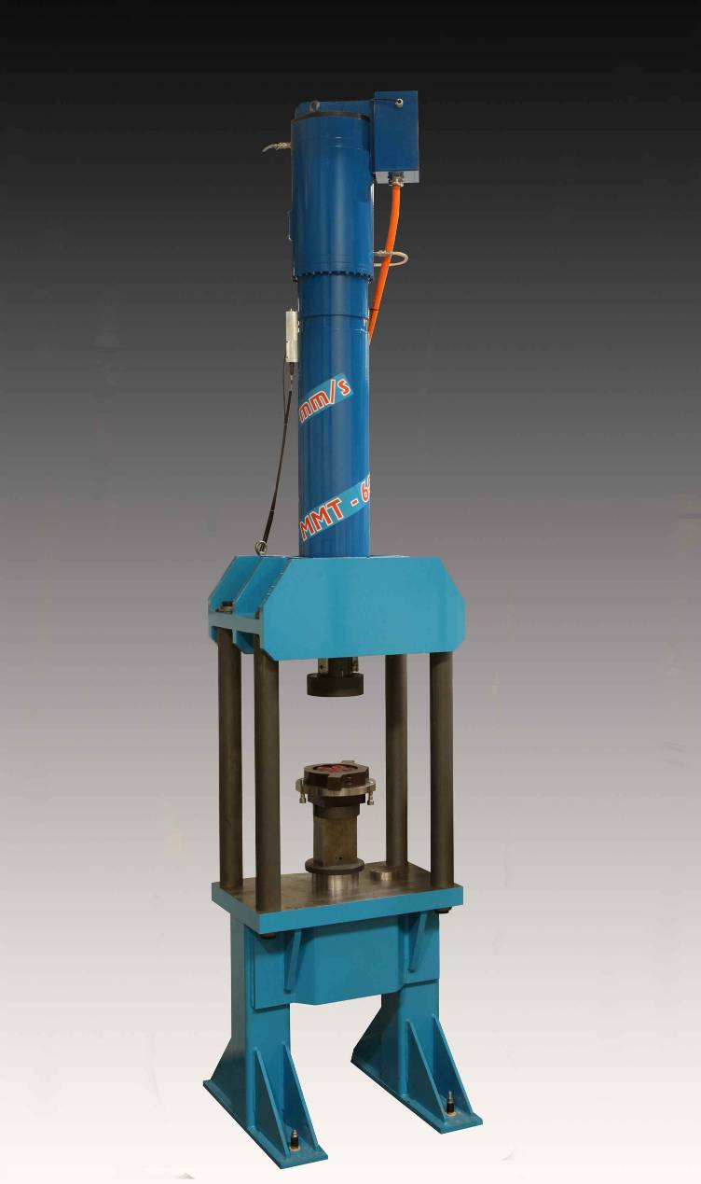
FSA ranges of Servo Presses
MMT Range : High Power – Design for FORMING
Type | Permanent Force | Stroke | Max Speed | Permanent force, thanks to water cooling
MMT200 | 200 kN | 600 mm | 900 mm/s
MMT300 | 300 kN |  | 790 mm/s
MMT400 | 400 kN |  | 560 mm/s
MMT500 | 500 kN |  | 450 mm/s
MMT600 | 600 kN |  | 335 mm/s
MMT800 | 800 kN |  | 220 mm/s
MMT1000 | 1000 kN |  | 175 mm/s
6'8"
A prototype is ready, we’re waiting for a market opportunity to industrialize this range

Slide 8
Equipments
Jan. 2020

Slide 9
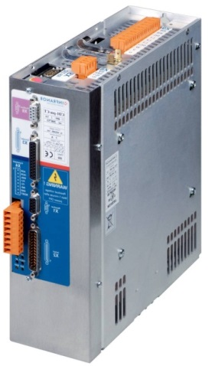
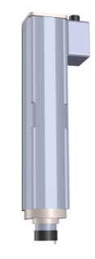
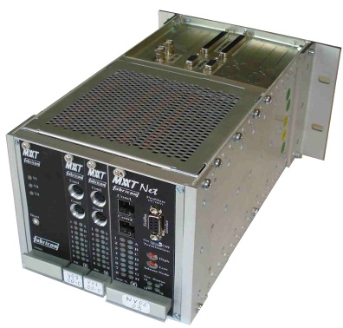
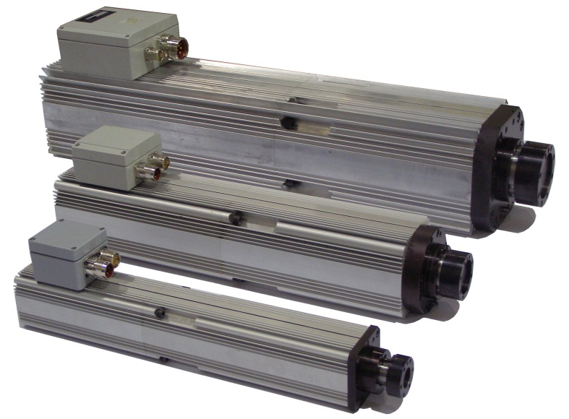
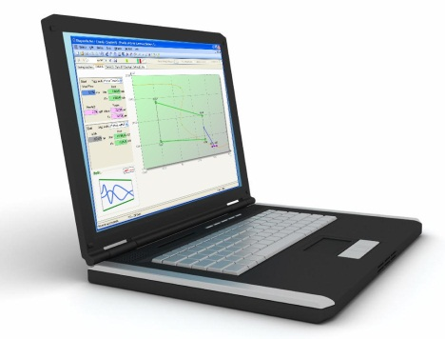
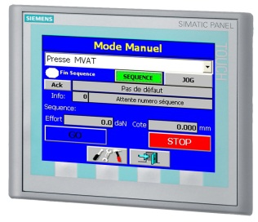
Equipment Overview
Servo with STO feature : PLd level (EN 13849-1) without extra-contactor
INFRANOR Brand
Cmd
MMT range High Power
← Force
NG
MMT
Displacement →
UG
Compact rack 2 channels + Fieldbus Interface
Electronics
865 mm
UG100 – 100kN
Course 300 mm
UG range Ultra-Compact
UG15 – 15kN
Course 300 mm
UG05 – 5kN
Course 300 mm
505 mm
505 mm
JR Automation - 12th of Dec. 2017

Slide 10
MVAT Electronics (FSA design)
FSA electronic controller :
Design and produced by FSA in Valence
Very competitive costs compare to external solution
Multi-Channel Design :
Compact version :
Up to 2 MVAT controllers
+ 1 Fieldbus interface
Standard version
Up to 6 MVAT controllers
+ 1 Fieldbus interface
152

Slide 11
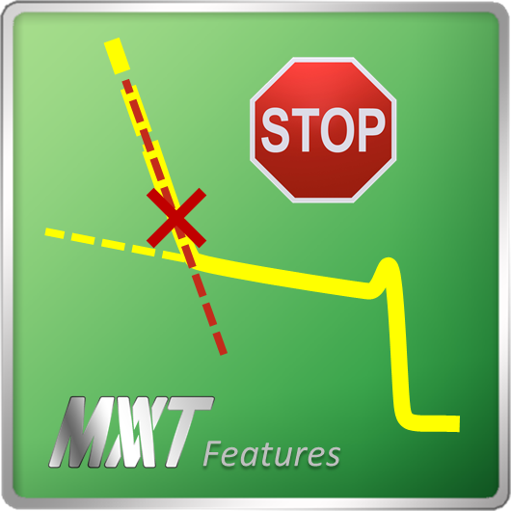
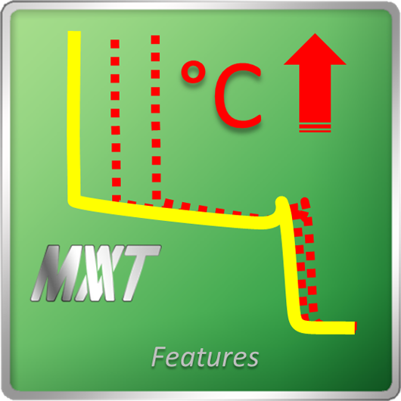
UG range main benefits
Process Expertise :
High accuracy under Force : +/- 0,01 mm
by dynamical compensation of flexion, unique on the market
Trip on Slope changing
Dynamical position correction with Temperature
Part rupture Detection

Slide 12
FSA philosophy
Now, displacement axis is settled down : the press is ready to work
“Calibration” :
- Learn the Zero including deformation
- Learn the practical resolution
x
0 displacement
Learning
TDC
H= x +/-0,01
F
0

Slide 13
Benefits of electrical Solution
12 - 2019

Slide 14
Benefits of Elec. vs Hydraul.
Total Process Control :
Force controlling, checking
Very accurate and repeatable position
High Flexibility
Very User-friendly interface
Earnings :
Cycle Time : -40%
Energy Consumption : -70%
Maintenance costs : -40%
Base area : -45%
Oil recycling/pollution : NO MORE
Safety - Noise : <75 dBA
Safety - Explosion : No more hostile fire risk, No more high pressure

Slide 15
Customers
Since 1999 : more than 600 presses in operation worldwide

